Slide 1
Transferabiliy Experiment

Slide 2
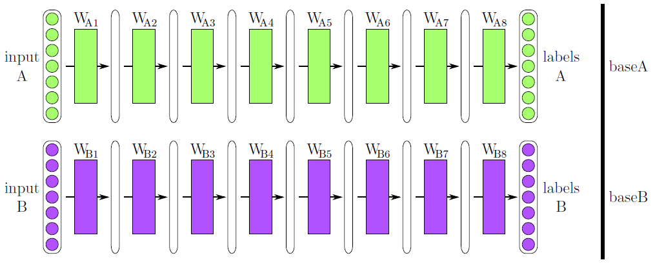
Base model

Slide 3
Cases (w/o diff learning rates)
n = number of layers to be transferred
Layers 1 .. n are always transferred, regardless the random init parameter!
 | Freeze (l<=n) | Random init (l>n)
Case 1,2 | True | True | Level n Feature Extractor („BnA“)
Case 3,4 | True | False | Complete Weight initialization with partial freeze
Case 5,6 | False | True | Level n Weight Initialization („BnA+“)
Case 7,8 | False | False | Complete Weight initialization without freeze
Identical for
n = 8 (complete frozen transfer)
Identical for
Case 3,4 n = 0
Case 5,6 n = 8
(complete unfrozen transfer)
Identical for
n = 0 (complete random)
Does not change with n. Regardless of n, all layers will be
transferred without freeze.
Corner case of Case 3,4 with n = 0 and of Case 5,6 with n = 8

Slide 4
Cases
 | Freeze | Random init | Discr learning rate
Case 1 | True | True | True | Level n Feature Extractor („BnA“) with discriminative learning rates
Case 2 | True | True | False | Level n Feature Extractor („BnA“) with constant learning rates
Case 3 | True | False | True | Complete Weight initialization with partial freeze with discriminative learning rates
Case 4 | True | False | False | Complete Weight initialization with partial freeze with constant learning rates
Case 5 | False | True | True | Level n Weight Initialization („BnA+“) with discriminative learning rates
Case 6 | False | True | False | Level n Weight Initialization („BnA+“) with constant learning rates
Case 7 | False | False | True | Complete Weight initialization without freeze with discriminative learning rates
Case 8 | False | False | False | Complete Weight initialization without freeze with constant learning rates

Slide 5
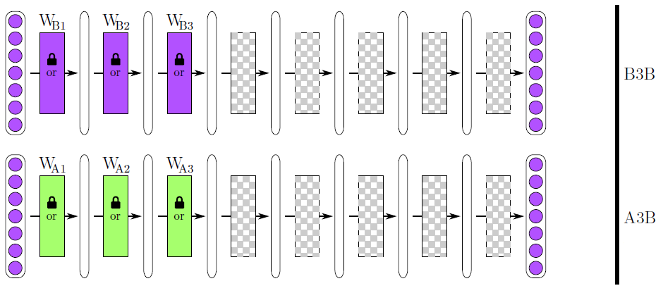
Cases 1,2 Level n Feature Extractor („BnA“)
n = 3

Slide 6
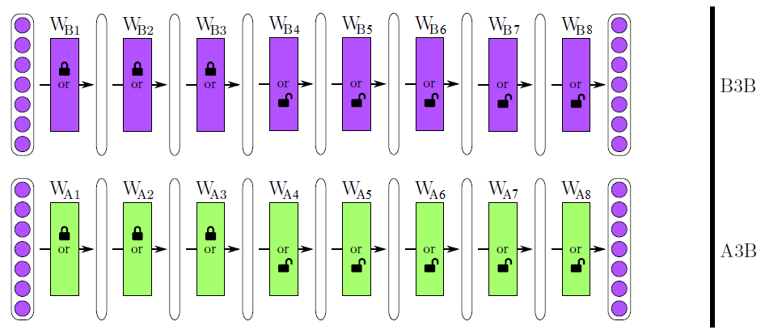
Cases 3,4 Complete Weight initialization with partial freeze
n = 3

Slide 7
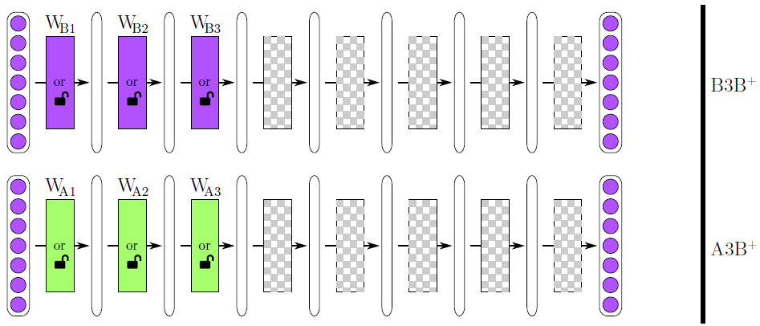
Cases 5,6 Level n Weight Initialization („BnA+“)
n = 3

